Slide 1
Commute Analysis for NYC Tourists
By Vamsi Chinta, Faraz Mirza, Alex Benitez, & Syed Kamil

Slide 2
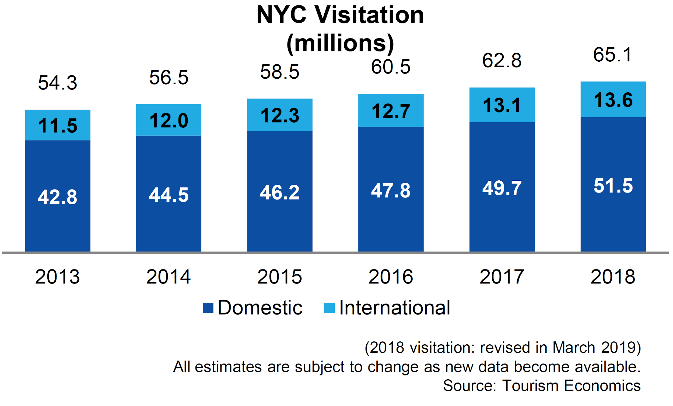
Motivation
New York is a famous city and there are millions of tourists visits the city every year. There are many options to travel within the city but we focused on the NYC Yellow taxi data to determine the best time and the cost to commute within the city.
Notes:
Motivation may Include:
Business Incentive
Market Trends

Slide 3
Objectives
Business Problem
NYC tourists waste valuable time and money on commuting since they are not familiar with the area and traffic flow
Objectives
Optimize commute time
Optimize commute cost

Slide 4
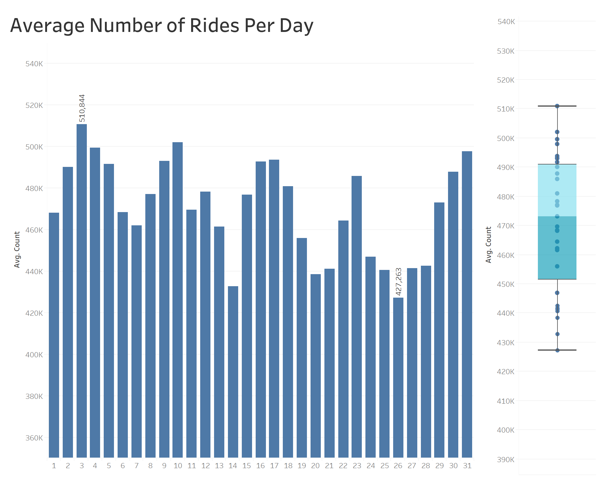
Data Understanding
Yellow Taxi Cab Data
29.4 million rides over a 2 month period
Each day having ~470,000 rides

Slide 5
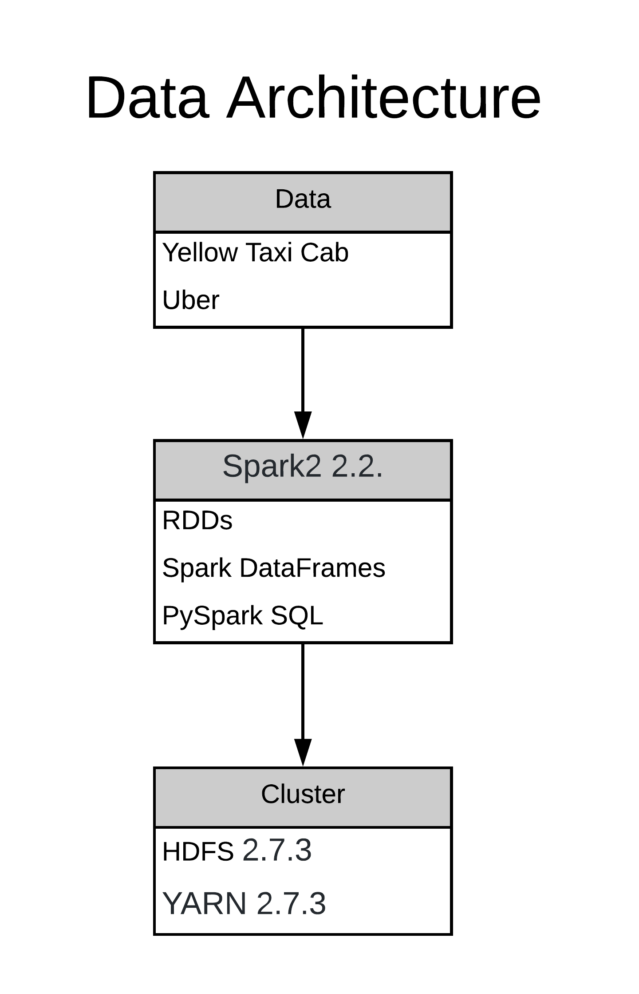
Architecture
Data Sources:
NYC Taxi and Limousine Commission
GitHub
Main Components we used:
Hadoop: Yarn, HDFS, MapReduce
Spark: Pyspark DataFrame, Pyspark SQL Functions, Pyspark MLlib

Slide 6
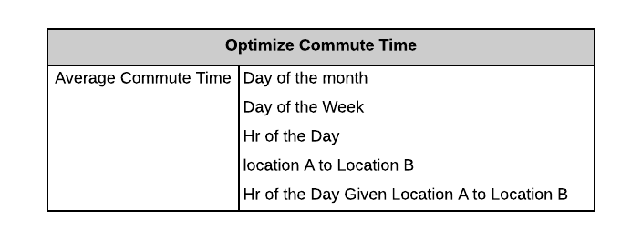
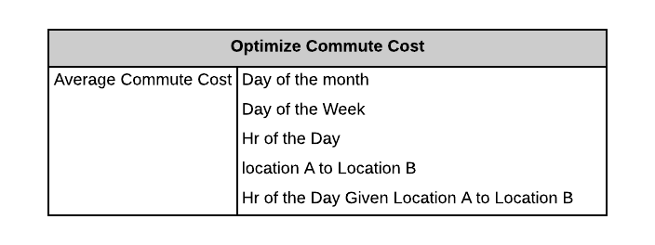
Analytical Framework
Important metrics related to the Analysis:
Average Commute Time
Average Commute Cost
PySpark DataFrame and SQL Functions to query relevant features for cleaning, EDA and Aggregated Results
K-Means Algorithm to cluster Pick-up/Drop-off Locations and Reverse Geocoding to map them into Neighborhoods and Zip Codes
Running Pyspark job on the whole dataset saved in Hadoop File Distributed System
Visualization of the Aggregated Results through Tableau

Slide 7
Results
Categorization of the project
Part 1
General Solution to any Tourist coming to visit NYC
Part 2
Tailored Solution based on where the tourist would like to travel to and from

Slide 8
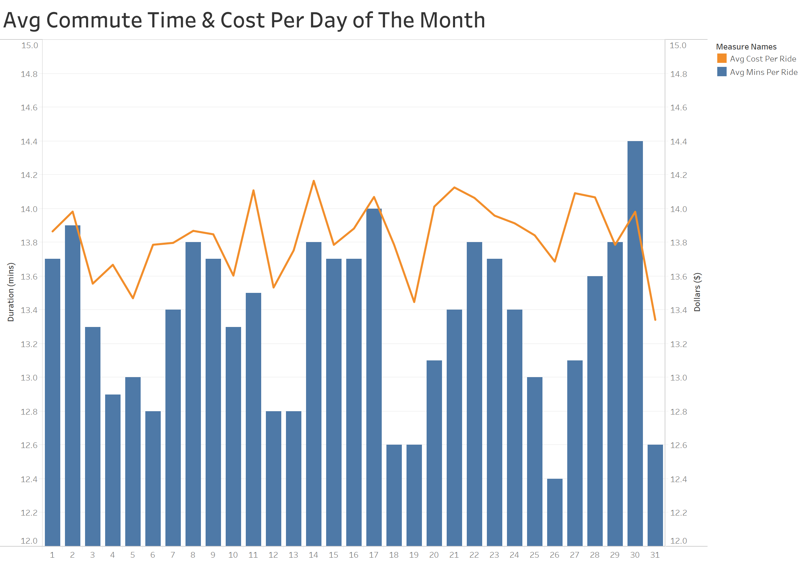
Optimal Day of the Month
Insights
Both average commute times and costs vary on a day-to-day basis; However, no trend is apparent
Business Impact
Recommend tourists to plan their trip around on any day of the month.

Slide 9
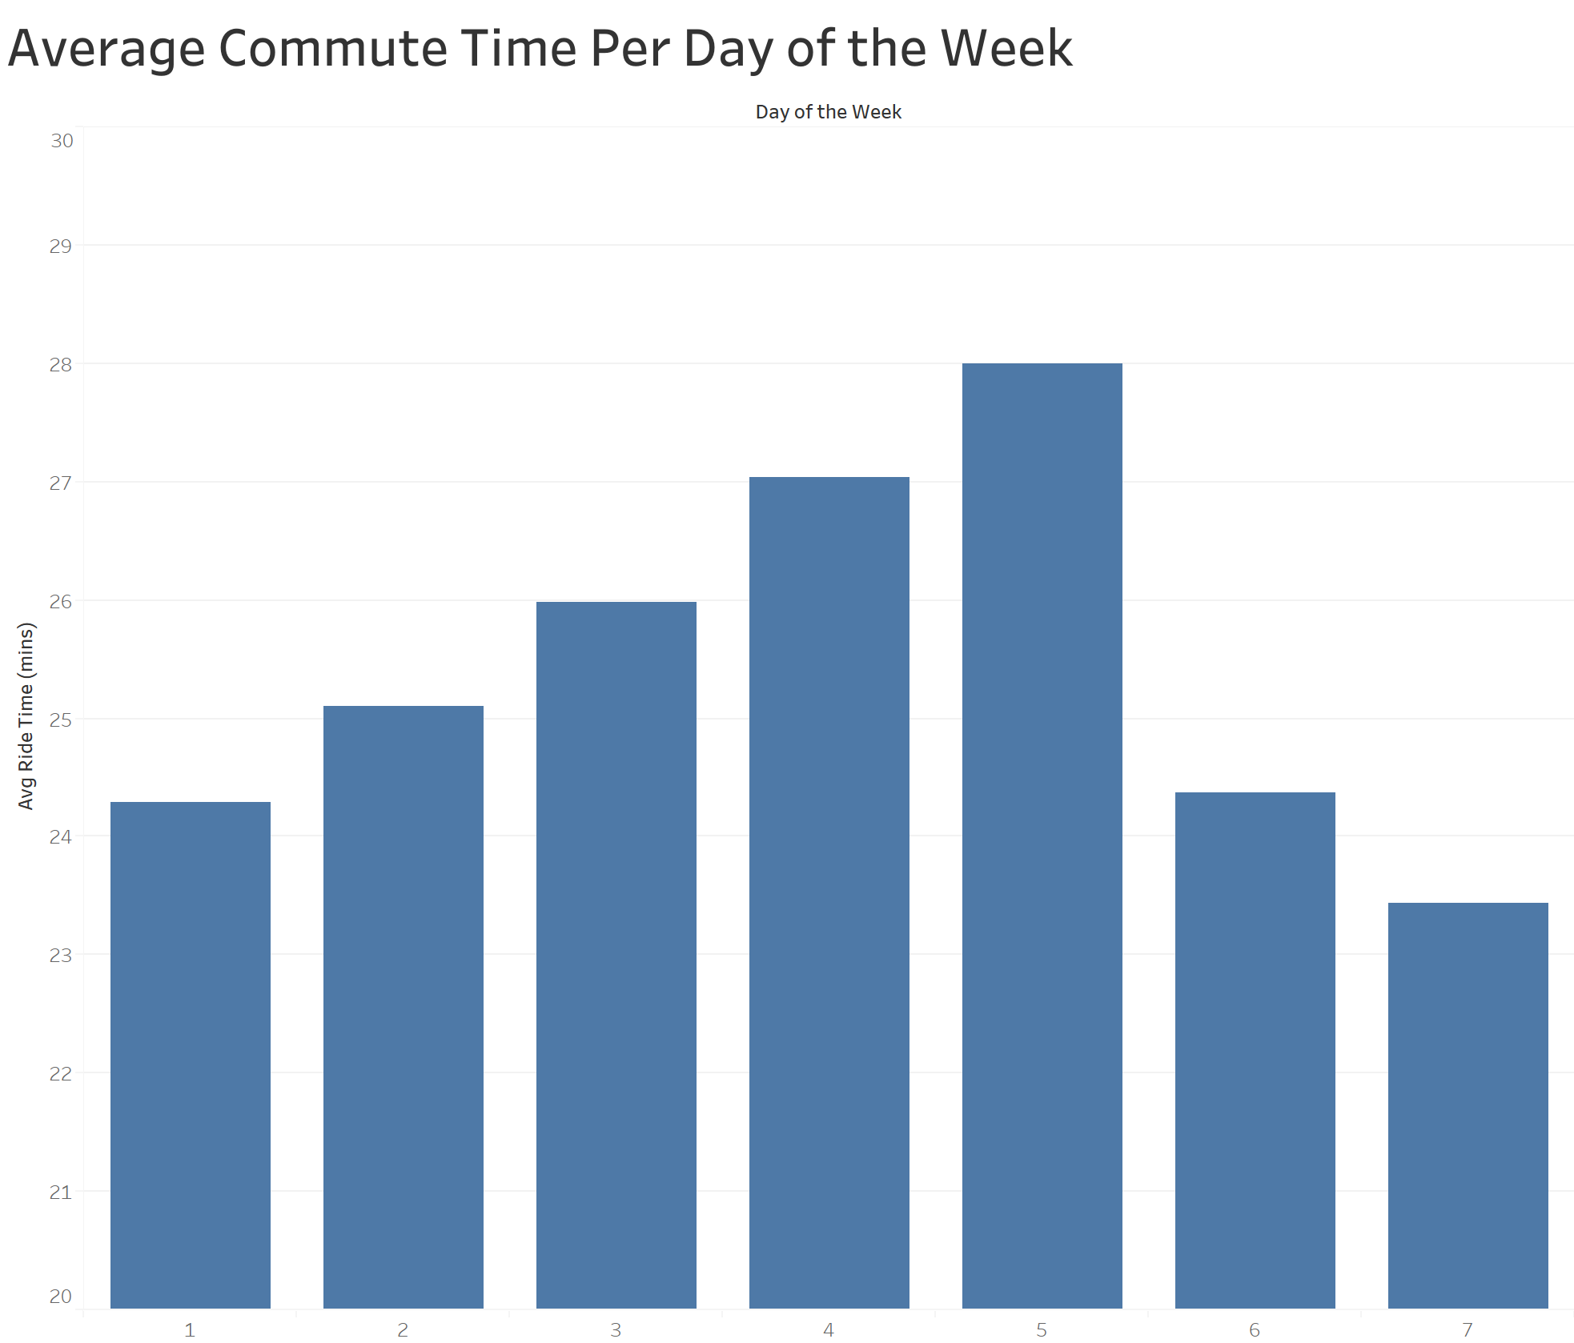
Optimal Day of the Week
Insights
On a weekly basis, we do see a trend in commute times
Business Impact
Recommend that tourist plans their visit on the Saturday and Sunday in order to to save time and spend less.

Slide 10
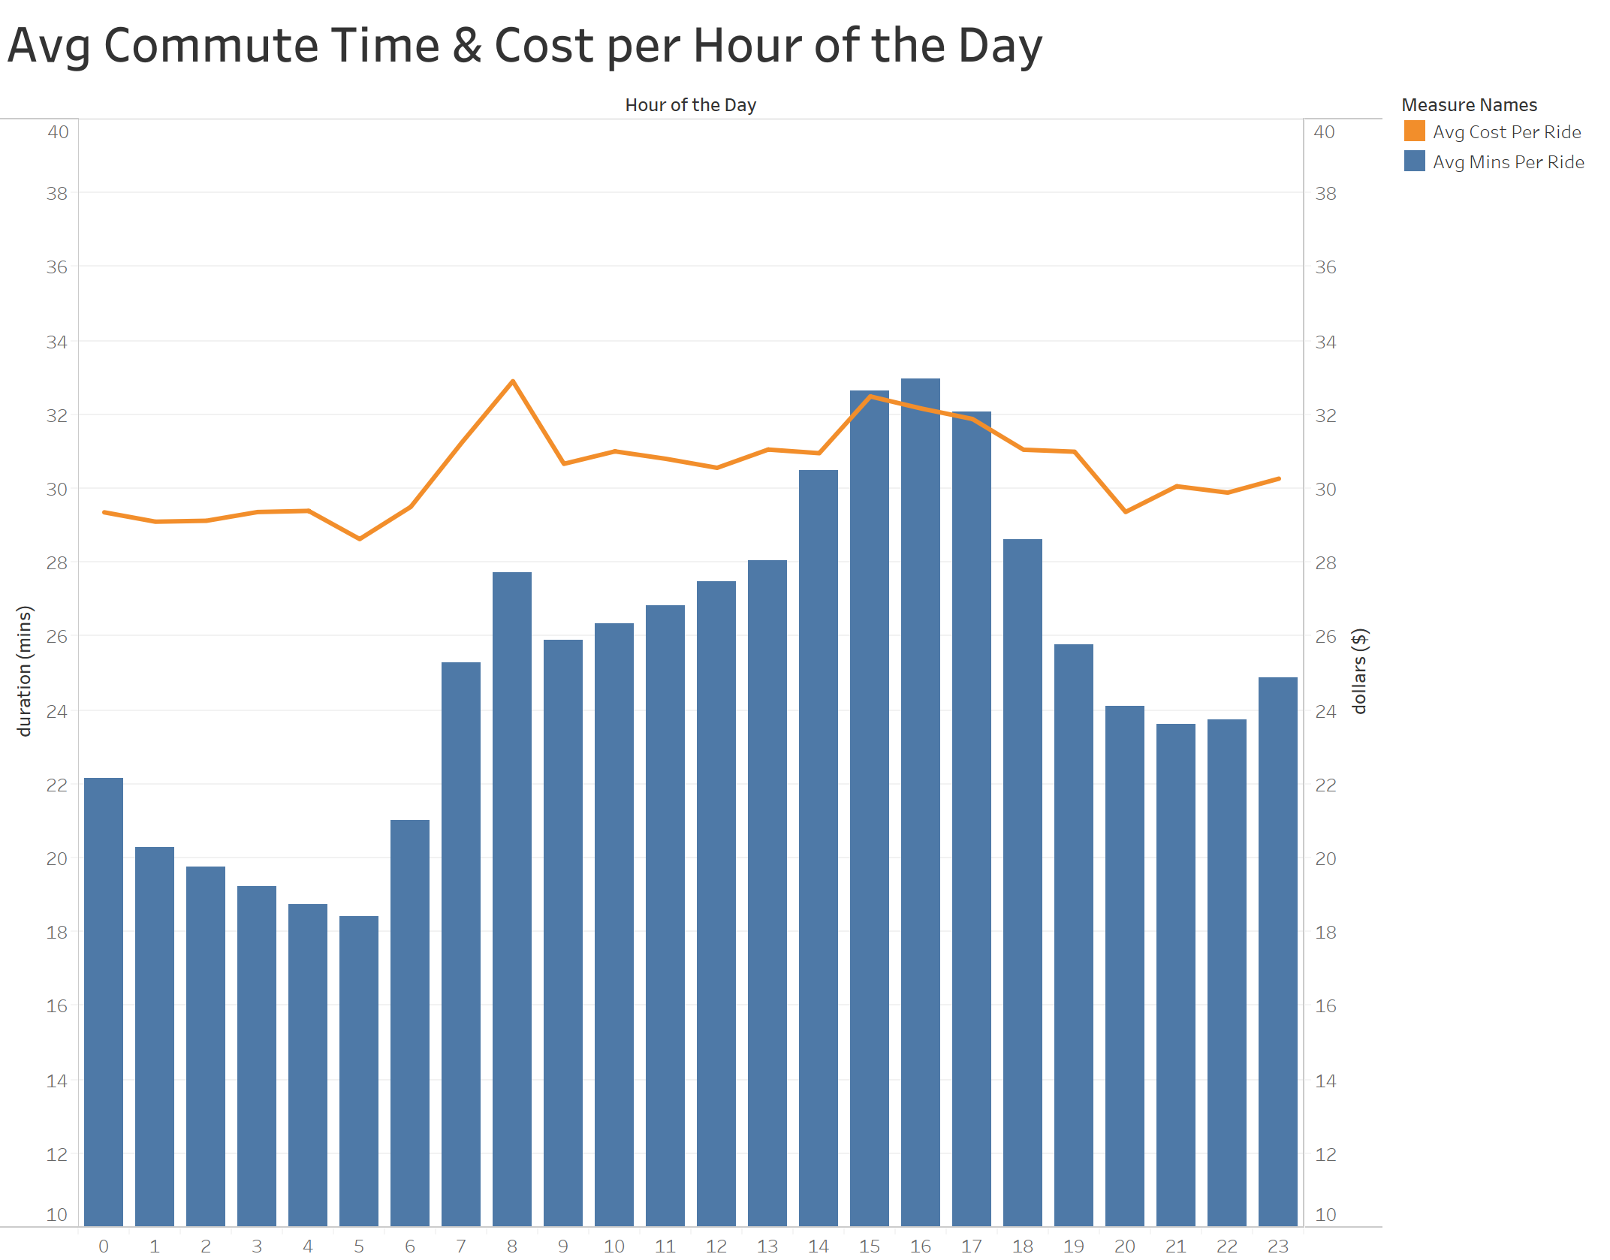
Optimal Hour of the Day
Insights
The commute time does depend on the hour of the day, but the cost does not
Business Impact
Recommend that tourists should avoid commuting during 2 to 5pm to reduce commute time

Slide 11
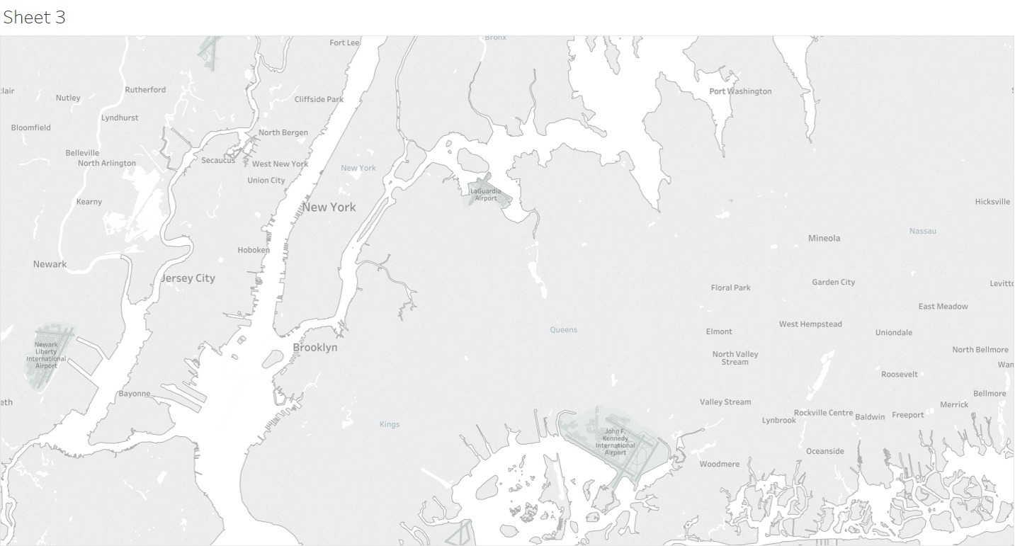
Results Part 2 - Estimates on commute cost and time for trips
With the use of the insights from part 1, we can tailor a solution for our customers.
The customer tells us where they’re commuting from and to. And we can tell them what they’re optimal commute time and costs will be.

Slide 12
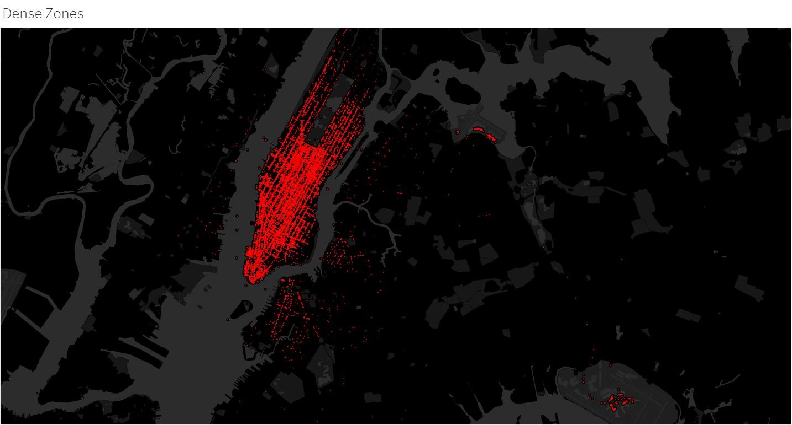
Cluster Analysis
Heat Map of Trip counts in NYC
Insights
There are areas where customers get picked up more frequently than other areas
Business Impact
We can use this insight generalize regions that we can use to estimate commute times and cost for tourists

Slide 13
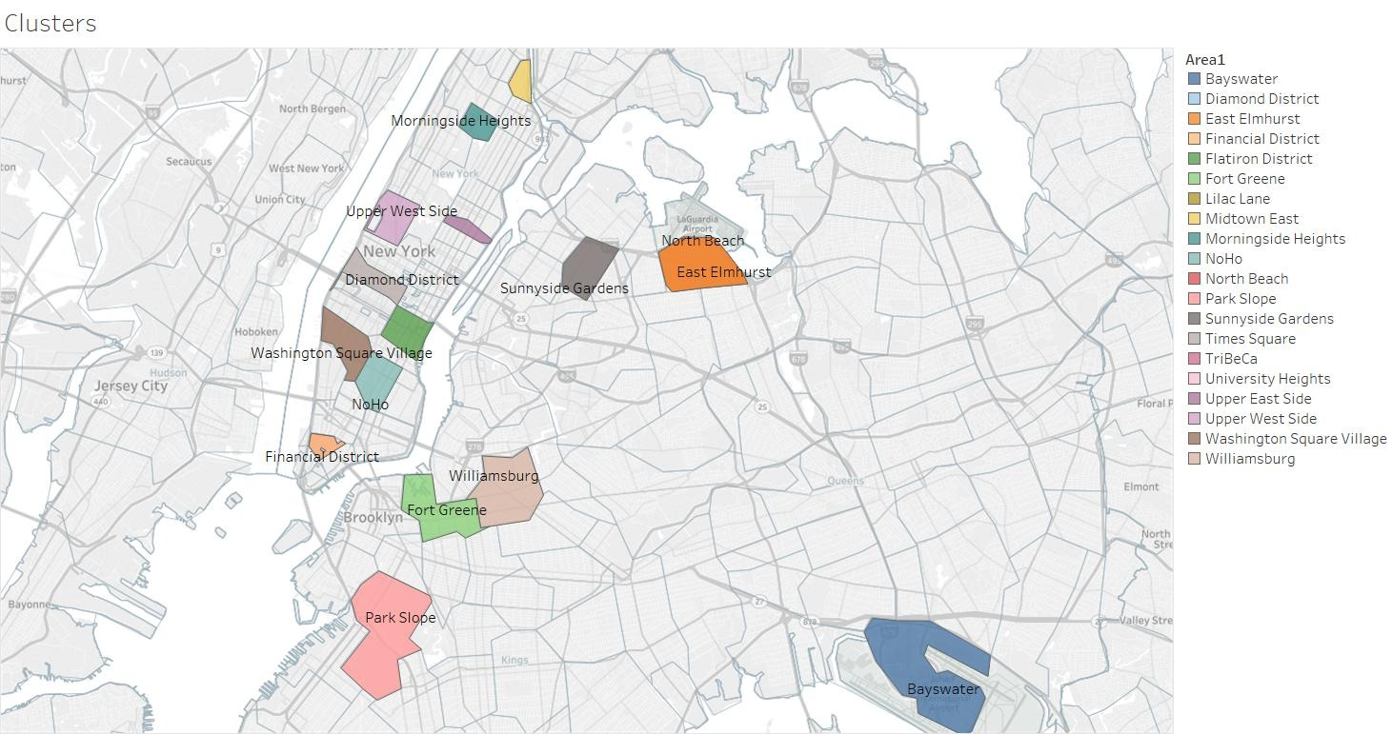
Cluster Analysis
Map of Regions with High-Volume of Commutes
Insights
Using K-means, we were able to define popular regions where tourists will be commuting from and/or to.
Using these regions, we can prescribe tourists in more detail.

Slide 14

Conclusion
To conclude our Analysis, we will illustrate a case study on Sarah, who is planning to visit New York City.

Slide 15
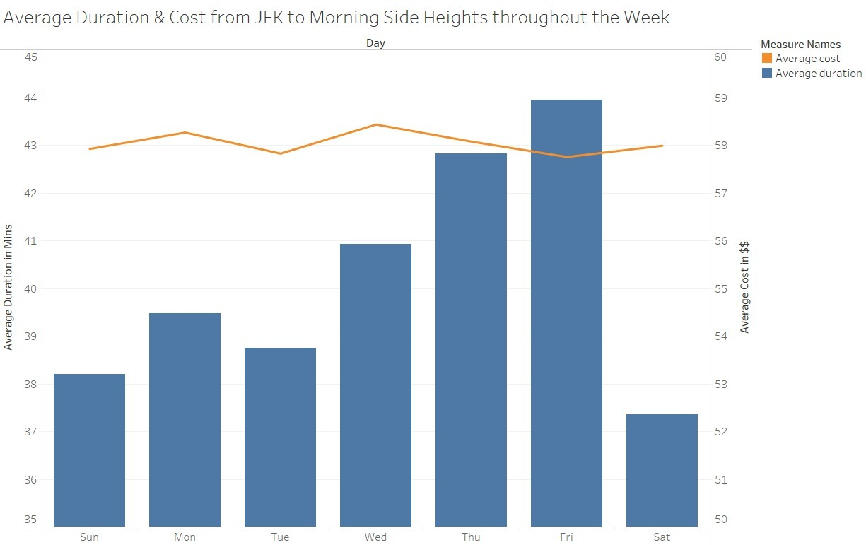
Case Study - Day of the week
Suppose Sarah wants to know how to best commute from the airport to her friend’s place in Manhattan
Solution
Sarah’s commute can vary based on what day she decides to commute.
We recommend she commutes to her friends place on saturday, saving her 7 mins and $0.50 on average.

Slide 16
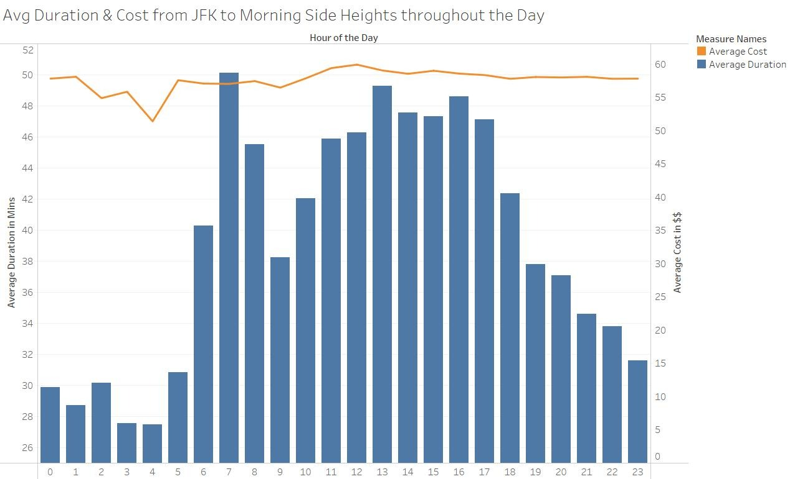
Case Study - Hour of the Day
Solution
Sarah’s commute can also vary based on what hour she decides to commute.
We recommend Sarah to avoid commuting between 6am to 6pm.
This will save her 24 mins and $4 in commute at max

Slide 17
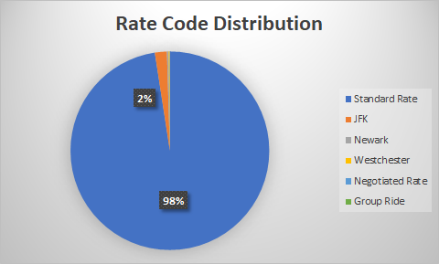
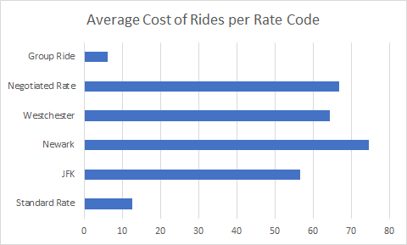
Interesting Insights
98% of the total rides were charged Standard Rate while the rest 2% were charged the JFK rate.
The count of rides that were charged from other categories were very negligible.
All categories are a lot more expensive than Standard and Group rate

Slide 18
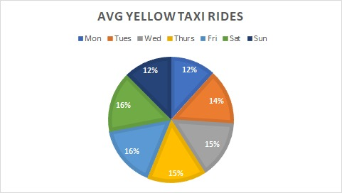
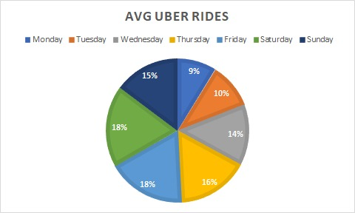
Comparative Ride Analysis B/W Yellow and Uber
Total Records: 29.4 Million
Total Records: 1.5 Million

Slide 19
Most Popular Neighbourhoods
Top Pickup Zones:
NoHo
Times Square
Garment District
Rose Hill
TriBeCa
West Village
Top Drop off Zones:
West Village
Financial District
SoHo
Chelsea
TriBeCa
Chelsea

Slide 20
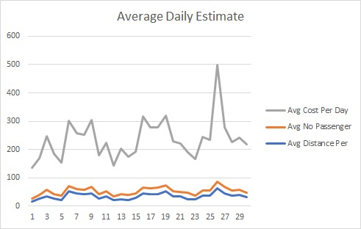
Average Daily Estimate
There was a huge spike in our average values for cost, passenger count and distance.
We looked into it and found out it was Memorial Day on 26th May 2014.

Slide 21

Thank You. Any Questions?

